Slide 1
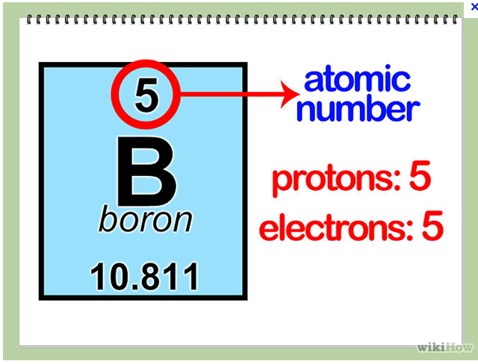
Neutrons
The # of neutrons is determined by:
  Rounded atomic _____ - Atomic ________
  Eg. Boron
    ____ – 5 = _____

Slide 2
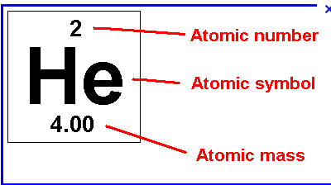
Neutrons
The # of neutrons is determined by:
  Rounded atomic mass - Atomic number
  Eg. Helium

Slide 3
Standard Notations
This is another way to write out the element and all the information about it.
It contains 3 steps:
  The _______ for the element is written out
  Then the Atomic ______ is written at the _______ left
  Then the Atomic ________ is written at the _________ left

Slide 4
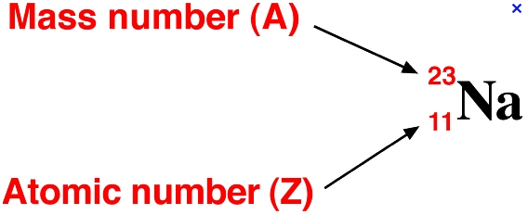
Standard Notation
This is another way to write out the element and all the information about it.
Eg. Sodium

